Slide 1

Hospitality Application
Emirates National Facilities Management

Slide 2
Introduction
EnFM Hospitality mobile application in a facility management business enhances the dining experience for employees or visitors.
It provides a user-friendly platform for users to view the menu, customize their orders, and place food requests conveniently from their smartphones.
The app offers features like pre-ordering, reducing wait times and promoting seamless transactions.
Users can also access nutritional information, receive personalized recommendations, and provide feedback for continuous improvement.

Slide 3
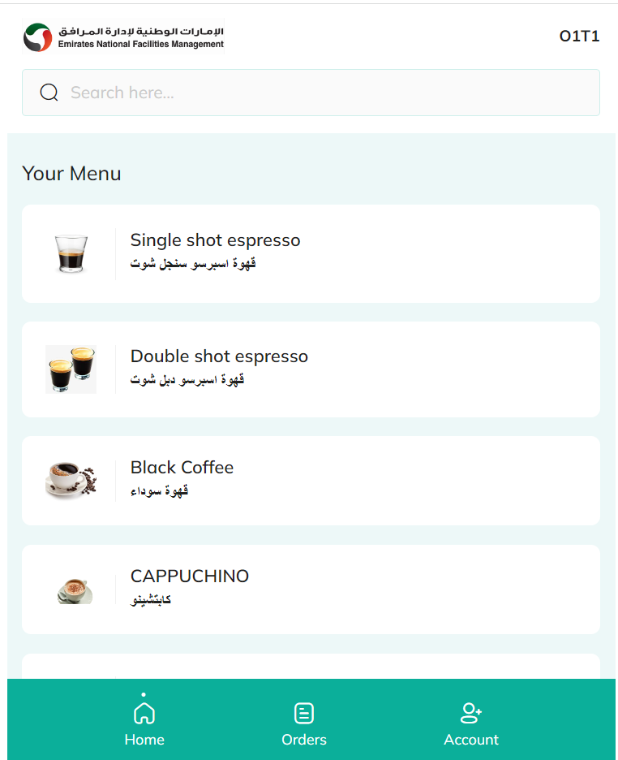
Book The Order

Slide 4
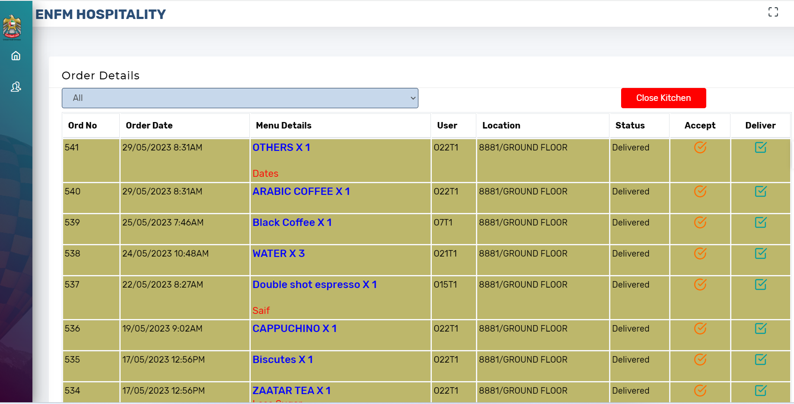
Pantry Staff Screen

Slide 5
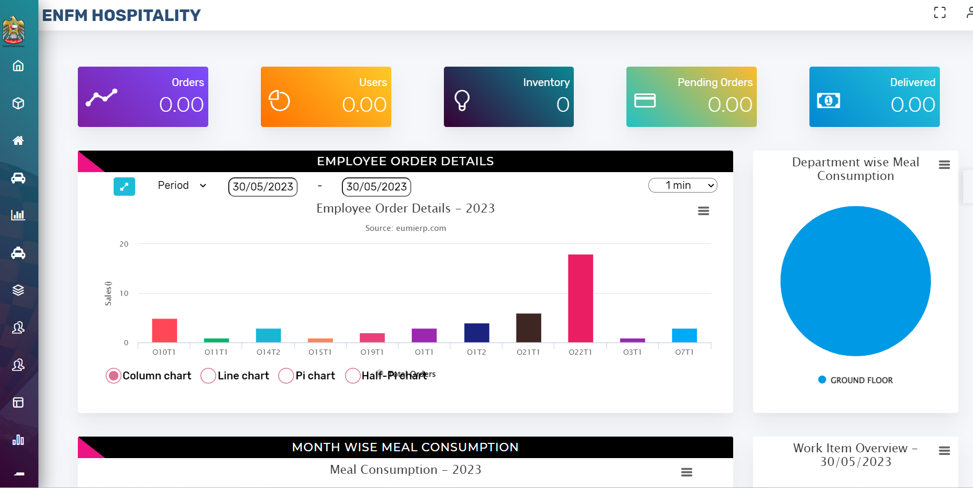
Management Dashboard

Slide 6
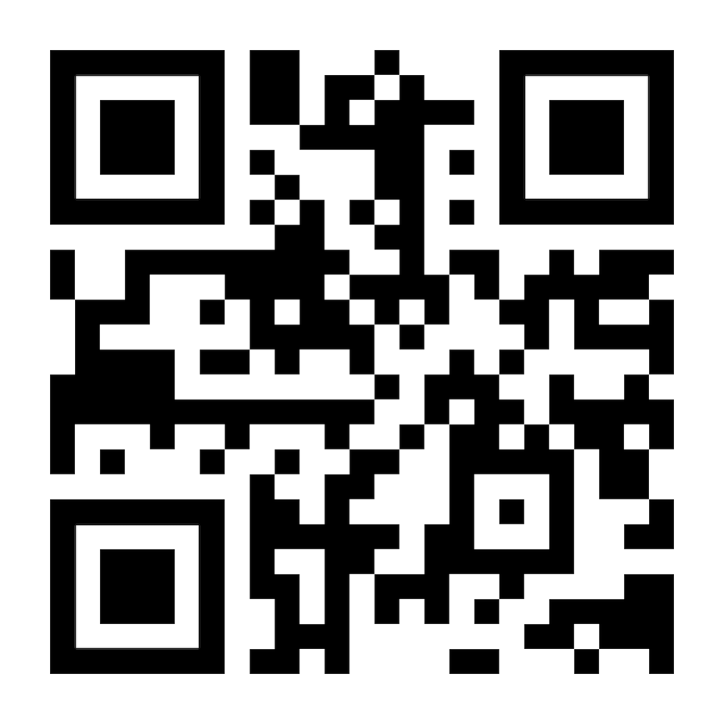
Hospitality App Proposal
500 QR
15000 AED
Annual Subscription

Slide 7
Thank you
www.emiratesnfm.ae

